Slide 1
Healthcare Spending and Outcomes Across Countries
Alex Orvis, David Oakes, Christopher McCormick, Bryson Webb, Pascaline Njouwou

Slide 2
Research Questions:
How does the amount of money a given country spends on healthcare affect their citizens’ actual health outcomes?
How do the percentages of people insured affect health care outcomes?
Does the way each country finances healthcare costs affect health outcomes?
Are healthcare outcomes in the United States also better as a result of increased spending?
Why is healthcare spending in the United States proportionally so much higher than healthcare spending in similar countries?

Slide 3
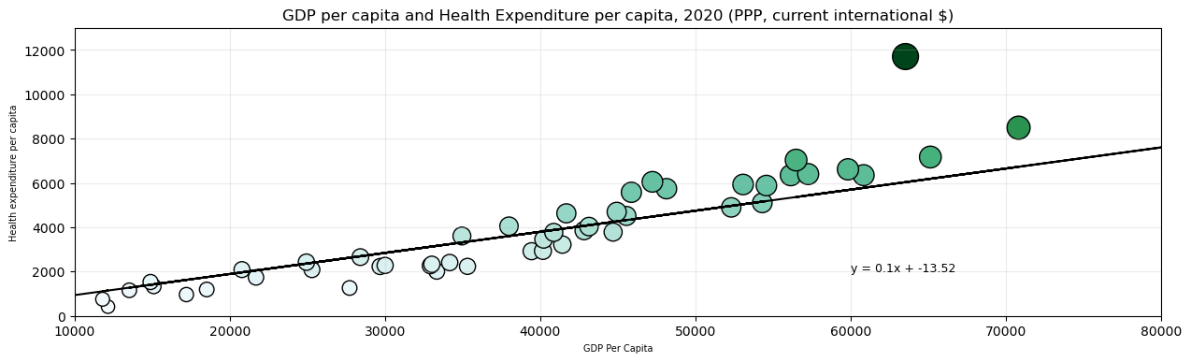
GDP Compared to Health Expenditure

Slide 4
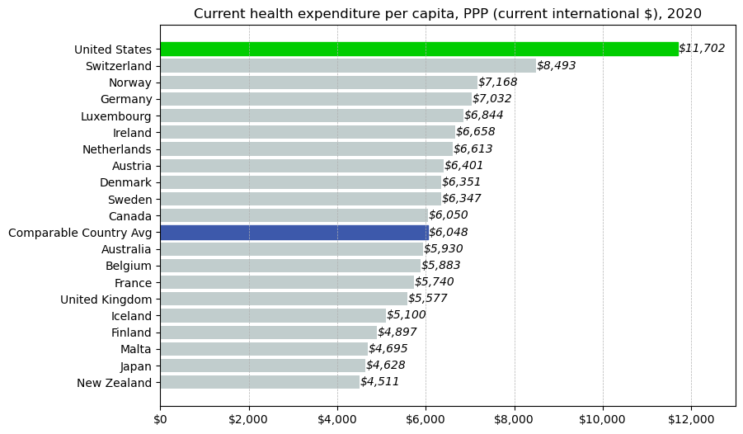
Current Health Expenditure Per Capita

Slide 5
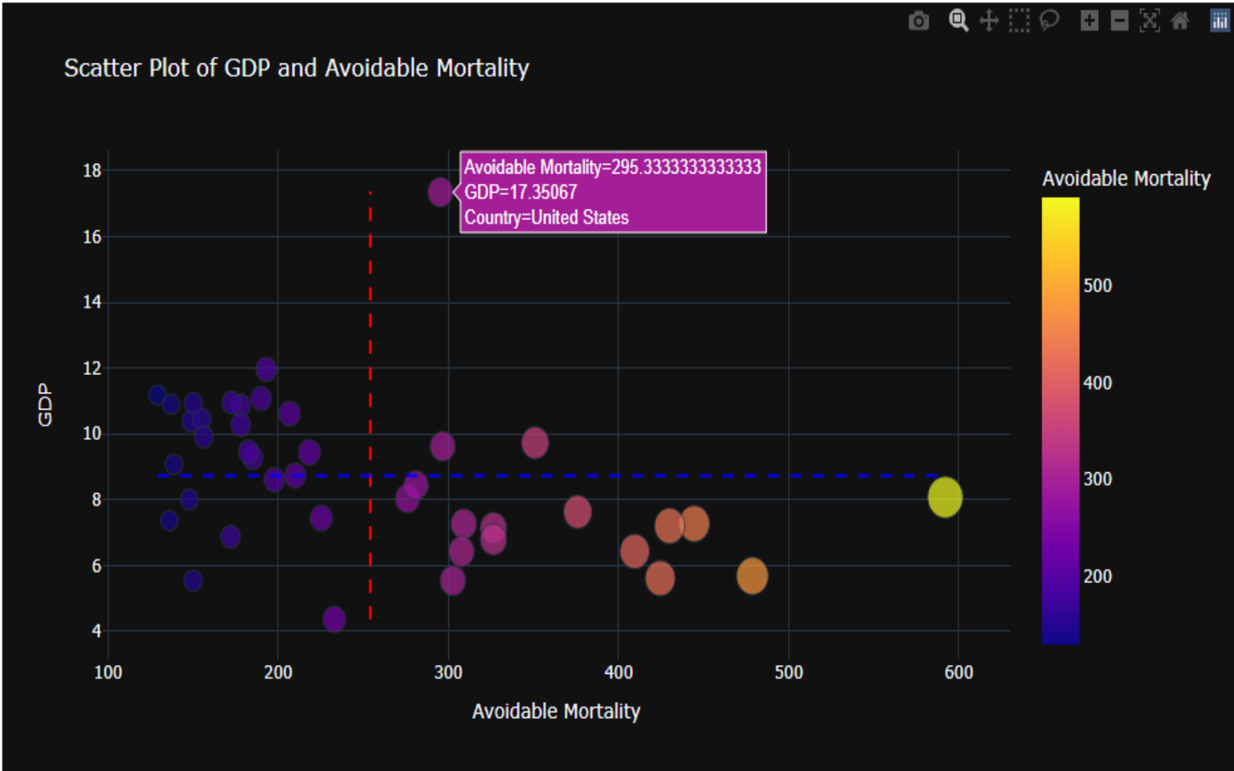
Healthcare Expenditure Percentage vs. Avoidable Deaths

Slide 6
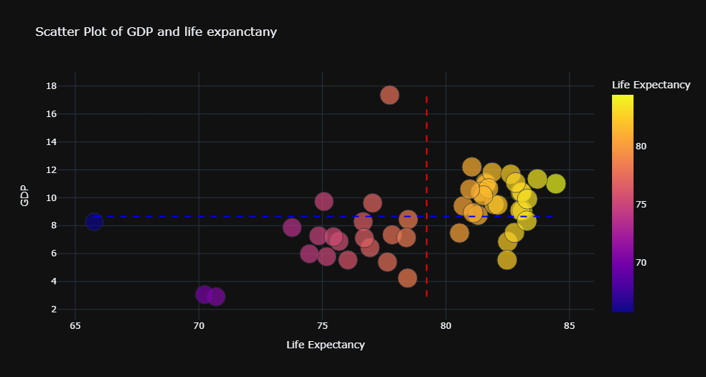
Healthcare Expenditure Percentage vs. Life Expectancy
Two-sided T-Test :
p-value: 0.95
Interpretation:
The life expectancy for the United States is not significantly different from the mean of all of the other countries.

Slide 7
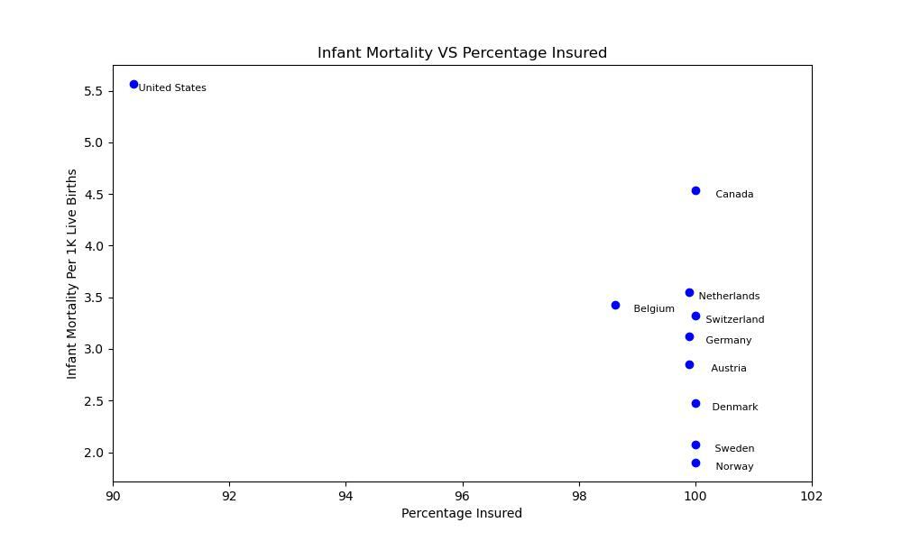
Infant Mortality Compared to the Percentage of Population with Health Insurance

Slide 8
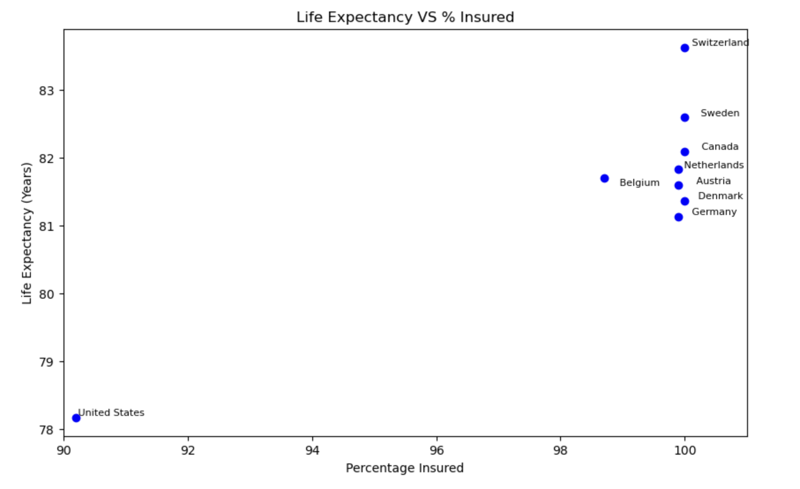
Life Expectancy Compared to the Percentage of Population with Health Insurance

Slide 9
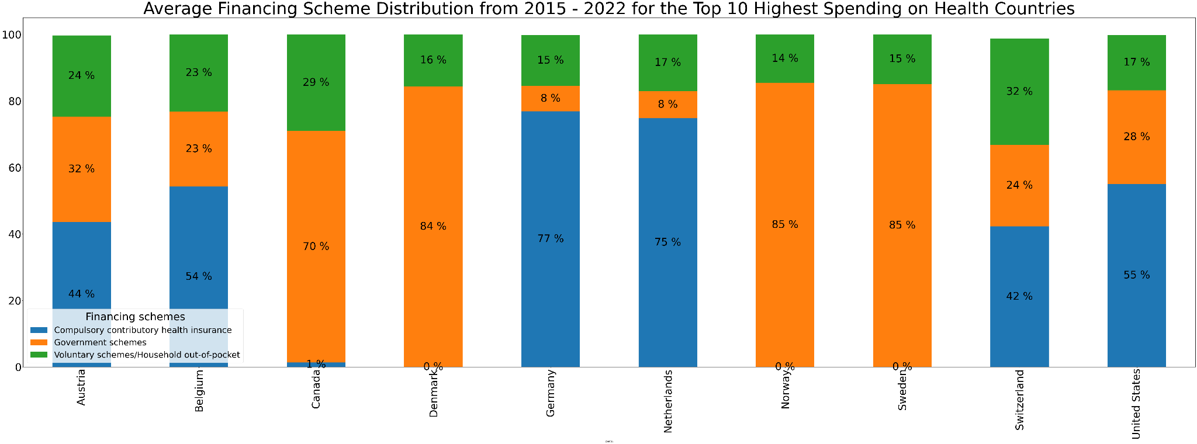
Top Ten Health Expenditures by Financing Scheme

Slide 10
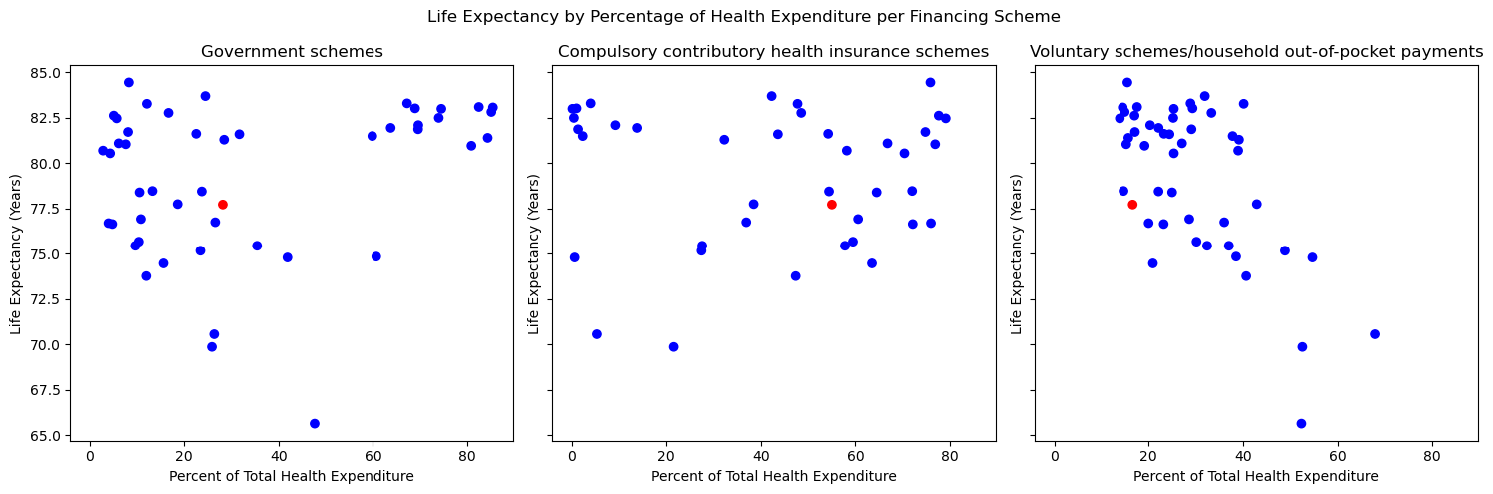
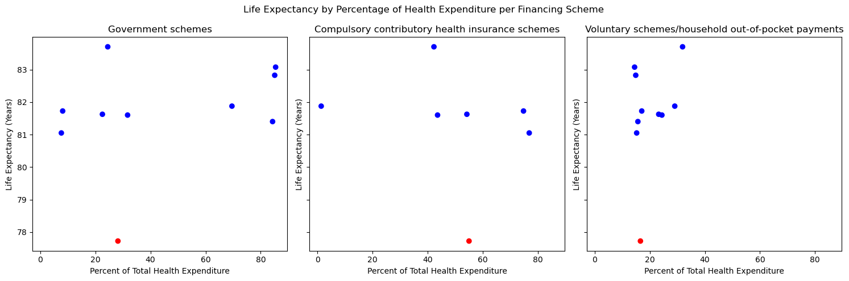
Life Expectancy Compared to Financing Scheme
ANOVA:
p-value: 0.99
Interpretation:
Variation seen between the three financing schemes is most likely due to chance

Slide 11
Summary
Though we failed to answer our main question - the data is immense and complex, the data revealed a number of interesting information about health spending and health outcomes in the United States
Limitations: we had a short amount of time for a huge amount of data, we could have used other data sources if we had more time. Our main data source only analyzed 51 countries.
If we had more time and resources we would have analyzed other socio-economic factors that influences health outcomes.

